Slide 1
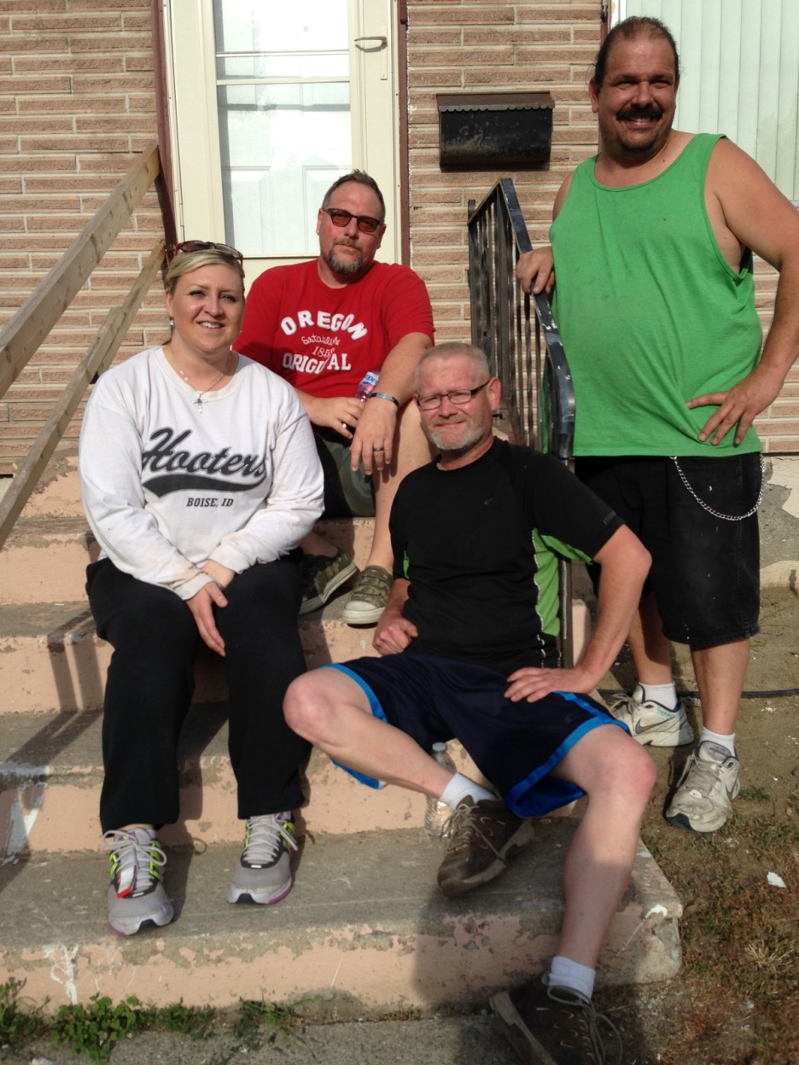
Revive Reentry Services, LLC
“Restoring life through reentry.”

Slide 2
Revive Reentry Services
Revive, meaning “to bring back to life,” ensures that individuals who have served time in a correctional institution will reenter society with support, a new direction and hope for a stable future.
Founded: June 2015
Department of Corrections approved Housing Vendor

Slide 3
Owned & Operated by
Layne Pavey, MSW, LIACSW, CPC
Program Director & Reentry Specialist Supervisor
(509) 998-8388
Bill Keizer, BA Ed, Graduate Certificate/Addictions Studies
Director of Housing & Education
(509) 720-3295
Dom Felix, BASW
Revive Reentry Specialist & Maintenance Contractor
(509) 217-7742
**Each owner is a formerly incarcerated person who has endured their own reentry process.

Slide 4
Expanding Our Services
Currently operate 3 Men’s Houses & 2 Women’s Houses
Unable to accept people with sex offenses, couples or families
Working with Drug Court to aid in diversion programs

Slide 5
Program Funding
Department of Corrections Voucher
SNAP Reentry Initiative Voucher
Pioneer/Drug Court Voucher
Housing & Essential Needs (HEN) Voucher
Self-Pay Contract

Slide 6
Impact of Mass Incarceration
70 Million Americans (1 in 4) have an arrest or conviction record
Currently there are 2.4 million Americans incarcerated
Over 600,000 individuals release from correctional facilities every year
On average 8,000 release from Washington state prisons every year (not including county jails or federal prisons in WA)

Slide 7
Impact Con’t
Incarceration is the most expensive and least effective way of deterring crime
It costs approximately $47,000 per year to keep someone incarcerated
Our country spends $80 billion per year on our criminal justice system
Recidivism rates still range from 50-80 percent depending on the state

Slide 8
There has to be a better way…
The top 2 factors in determining whether or not someone will re-offend is whether or not the person has a job and stable housing
Unfortunately, within one year of being released only 25% of returning citizens have a job
No job=no housing

Slide 9
Mission Goals
Provide a foundation for recovery from justice system involvement, substance abuse, mental illness and homelessness
Decrease recidivism
Provide Peer Mentoring from qualified former offenders who have successfully reintegrated and recovered after serving time
Carve a path for successful reentry by collaborating with Community Based Service Professionals to ensure the continuum of care necessary for successful reintegration
Connect individuals with community supports to ensure long-term success

Slide 10
Services
Safe transportation from the correctional facility to the new release address
Help with acquisition of essential needs including State ID, food assistance and bus passes, as well as connection with Community Based Service Professionals and Community Corrections Officers
Revive Reentry Specialists provide full case management, aiding our clientele in creating and implementing their own person-centered, strengths-based 90 Day Reentry Plan to ensure success in their reintegration, recovery and a restored sense of self-sufficiency.

Slide 11
Five Pillars of Successful Reentry
Employment/Income
Stable Housing
Family Restoration
Pro-social Activities/Life Style
Community Support

Slide 12
Pillars of Revive Reentry
Safe, Trustworthy, Relationships
Trauma-informed Care
Social Inclusion & Community Building
Celebrating Release & Recovery
Restorative Consequences
Education
Purpose
Hope
Belonging

Slide 13
Questions: Please contact Layne Pavey at revivereentry@gmail.com (509) 998-8388 Intake: Please contact Bill Keizer at revivereentry1@gmail.com (509)720-3295

