Slide 1
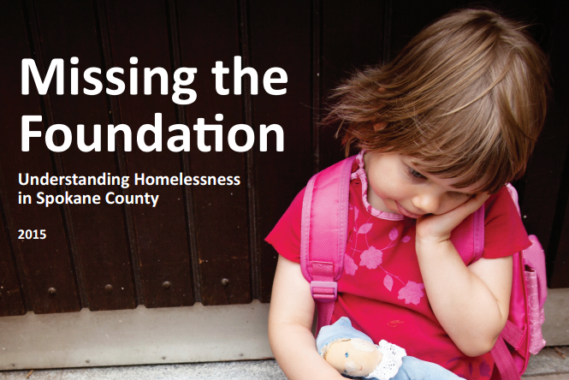
Rallying Around Data
Lyndia Wilson
October 6, 2016
Homeless Coalition

Slide 2
Public Health Framework
Assessment Sections
  Homelessness in Spokane County
  Root Causes and Impact of Homelessness
  Assets, Initiatives, Recommendations
Collective Work
Results from report
Lessons learned
Questions

Slide 3
Public Health Framework
Interview stakeholders
Identify data resources
Compile data
Inventory assets, efforts, model practice
Identify gaps and issues
Distribute widely
Use data

Slide 4
Why use data?
Compilation of information
Education and awareness
Program decisions
New partnerships and collaborations
Policy changes
Grant writing
Strategic planning and prioritization
Evaluation of efforts

Slide 5
Homelessness in Spokane County
PIT Count: 1,033 (2015)
Schools: 3,013 (2014)
Community Service Providers: 5,000/year
Other Considerations
  Under-estimated reports
  At-risk for homelessness

Slide 6
Root Causes
Research consistently points to two key factors as root of homelessness:
poverty
lack of affordable housing

Slide 7
Cost of Basic Needs in Spokane
Cost-Per-Month for
Basic Needs for a
Family of Four,
Spokane County,
2014
Cost of basic needs
equates to 180% FPL
Approximately 34% or 1 in 3 Spokane County households do not have enough income to meet their basic cost of needs
Food | $870
Housing | $702
Utilities | $153
Transportation | $262
Child Care | $1,088
Health Care | $212
Personal and Household | $330
Total | $3,617

Slide 8
Affordable Housing in Spokane
Affordable housing equates to 30% or less of household income
In 2013, 54% of renters in Spokane County were paying more than 30%

Slide 9
Circumstances and Characteristics Contributing to Homelessness:
  Lack of, or difficulties accessing, social supports and services
  Personal catastrophic events
  Domestic violence
  Drug and alcohol use
  Debilitating illness (Mental Illness)
  Discrimination (gender, race, etc)

Slide 10
Vulnerable Populations At-risk:
Mentally ill
Single parents
Veterans
Children
Foster youth
Elderly
Incarcerated

Slide 11
Homeless Adult Physical and Mental Health:
  Significantly poorer overall health
  High cholesterol
  High blood pressure
  Limited activity
  Higher levels of depression
  Higher levels of tobacco Use
  Don’t have insurance, could not see a doctor due to cost

Slide 12
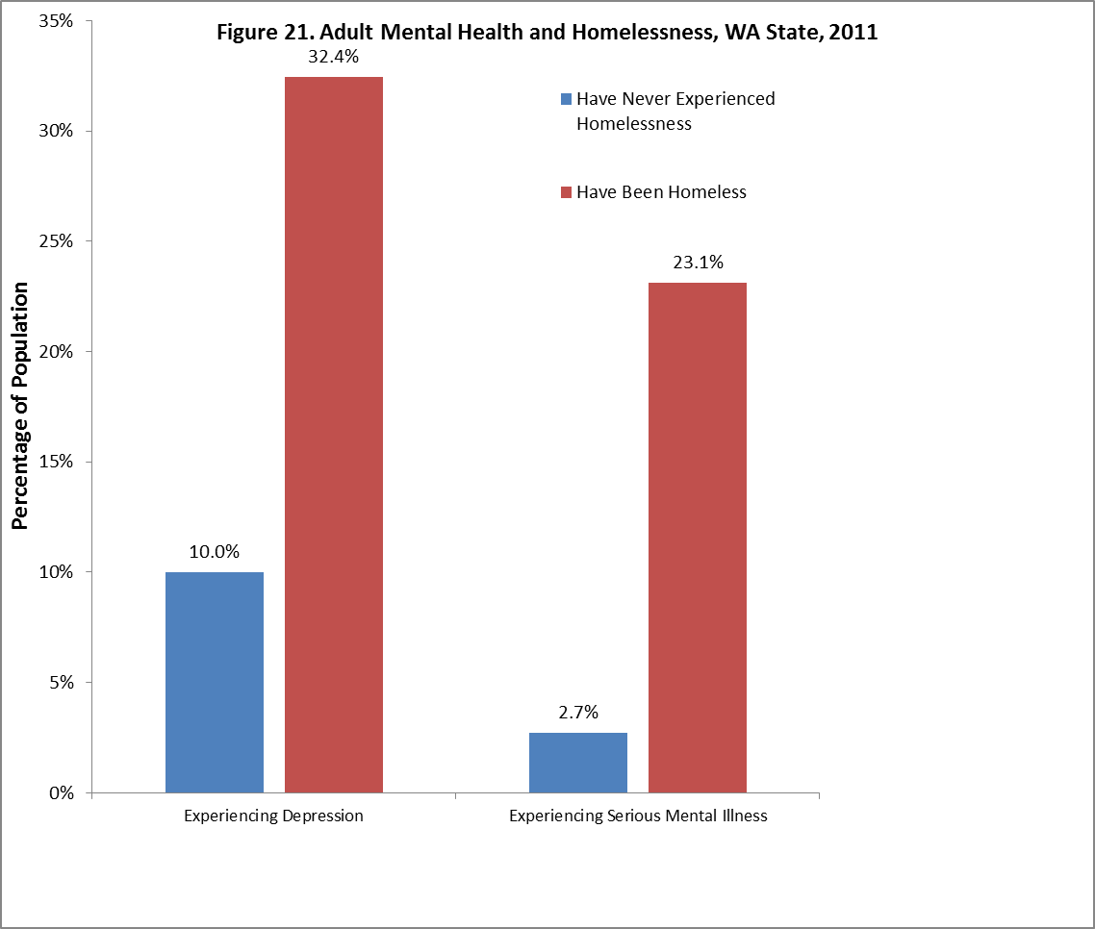

Slide 13
Homeless Youth Health and Education:
  Less likely to feel like they can go to a parent for help
  Do not look forward to the future
  Feel alone in life
  Depression
  Seriously considered, planned or attempted suicide
  Mobility
  Attendance
  GPA

Slide 14
Impact of Homelessness in Spokane
Societal: Stigma of homelessness; basic needs not met, can’t become productive citizen
Financial: Millions of dollars spent on addressing homelessness by government, medical system, utilities, social services, and more
Health: Long term health impact

Slide 15
Assets, Initiatives, Recommendations
Local, state, and national funding and programs for the homeless
Affordable housing efforts
Legislation passed
  SB 5405 and HB 2263
Recommendation themes
  Data sharing
  Community coordination and system improvements
  Prevention
  Discrimination and quality of homes

Slide 16
Alignment and Coordination
COLLECTive Work
Isolated Work

Slide 17
No single organization or sector can solve complex social issues
Engagement with new partners imperative
Redefine your role within a larger context for impact
Coordinate agendas with other partner organizations to reinforce activities

Slide 18
Think about long term process and gradual impact rather than short term solutions
Communicate regularly and openly with each other – spend time on relationship building
Redirect activities if needed
Collect and analyze relevant data for shared measurement

Slide 19
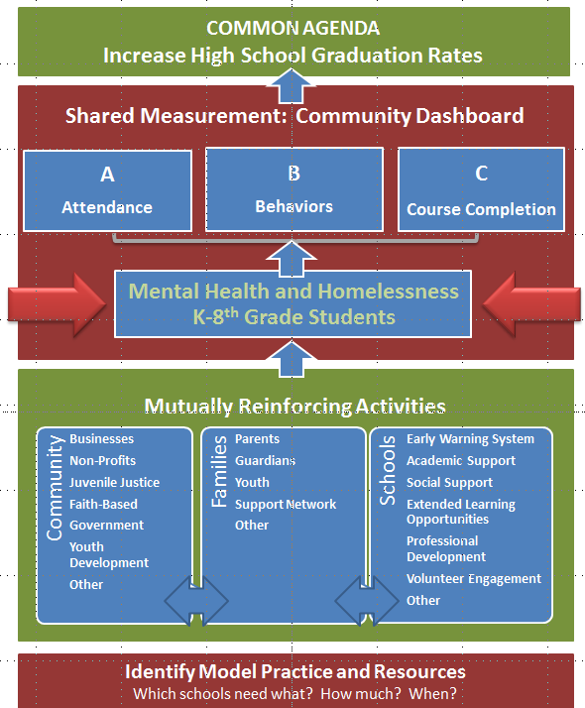

Alignment and Coordination
Notes:
LCW

Slide 20
Rallying around Homeless Data
Awareness and education
Planning
Defined populations for investors
Connections between sectors and interest areas
New partners
Resources obtained
Measurement

Slide 21
25 Years of Lessons: Community Work
Focus effort
What gets measured, gets done
Use model practice that works
Increase cross-sector alignment and learning among organizations
Expand partners to new ones, including funders, business
Take time to build relationships
Align work and increase momentum
Leverage resources (new or redirected)

Slide 22
Collective Impact Model for Homeless
Shared goal
City and County Projects
Support Services
Community Collaborations
Local to national legislation
Non-profits
Housing Providers
Investors
Questions?

