Slide 1
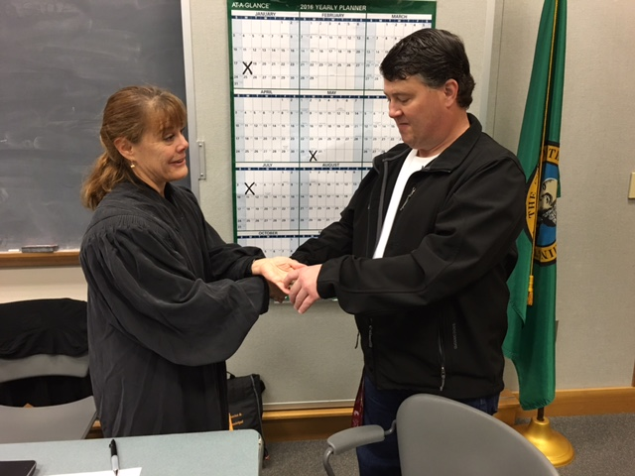
Spokane Community Court:
Restorative Justice for the Individual
Judge Mary Logan Francis Adewale Public Defender David Kling City Prosecutor

Slide 2
Session Goals:
Detail the community court model and the need for collaboration across agencies of government
Describe Process for Participant in Community Court
Highlight the benefits of Community Court for both participants and service providers
Emphasis on community working together
City of Spokane Municipal Community Court

Slide 3
Principles of Community Court
Mission: Build stronger and safer communities by providing accountability with help
A collaborative, problem-solving approach
Individualized justice
Improve quality of life for participants the community
Promote fair, equitable, and responsive policies
Find family and community-oriented solutions
Expand employment and education opportunities
Community and neighborhood improvement through sustainable environmental awareness and action
City of Spokane Municipal Community Court

Slide 4
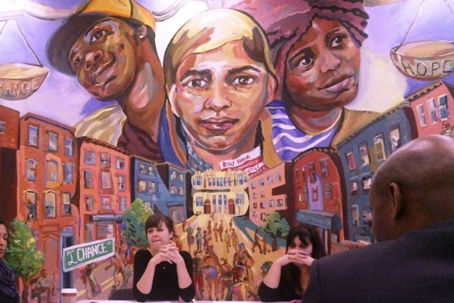
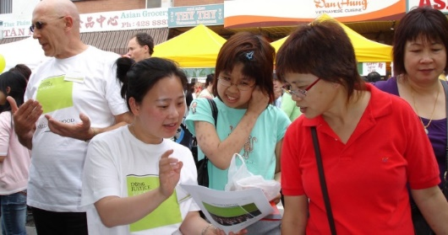
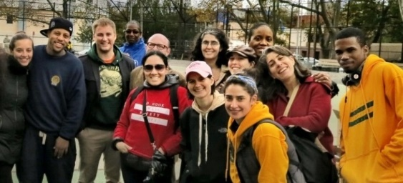
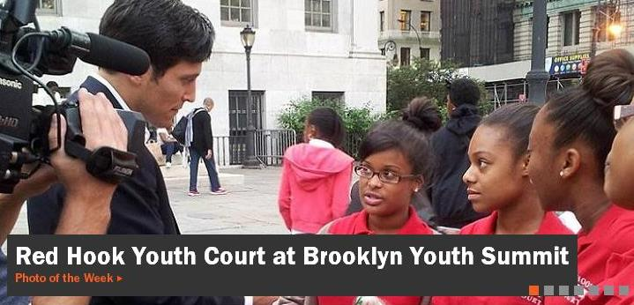
Community Court: National Trends
70+ programs in planning or operation
Implementing and validating assessment tools
Restorative justice, peacemaking
Young adult justice
Handling more serious offenses
Paired with diversion options for earlier intercepts
Testing city-wide models

Slide 5
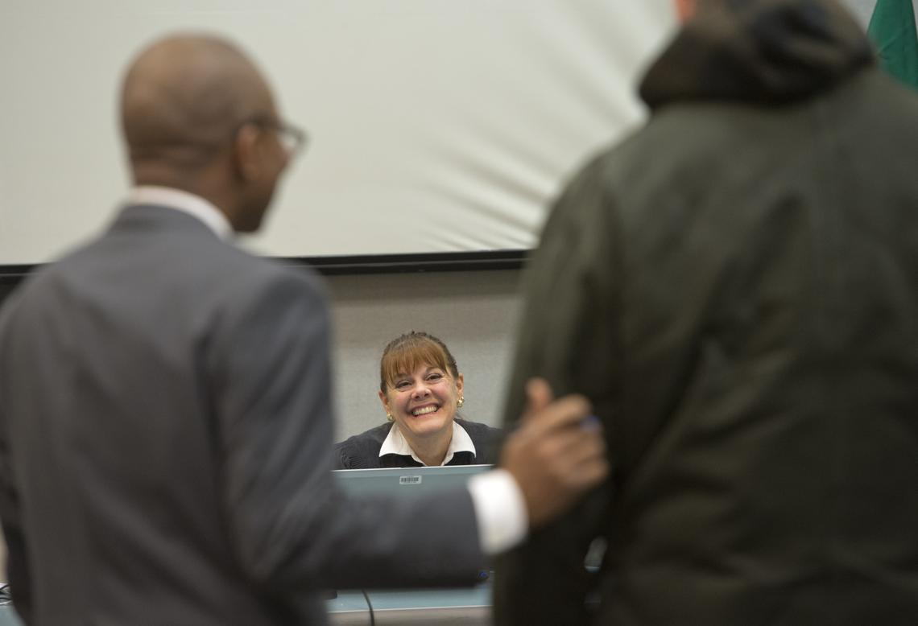
The Community Court Process: Path to Graduation
Pre-Arrest
An eligible crime is committed in the neighborhood
First Community Court Appearance
Needs Assessment
Participant enters the resolution on the record with the Judge
Staffing and Weekly Status Update
Final Review Hearing Held
Graduation

Slide 6
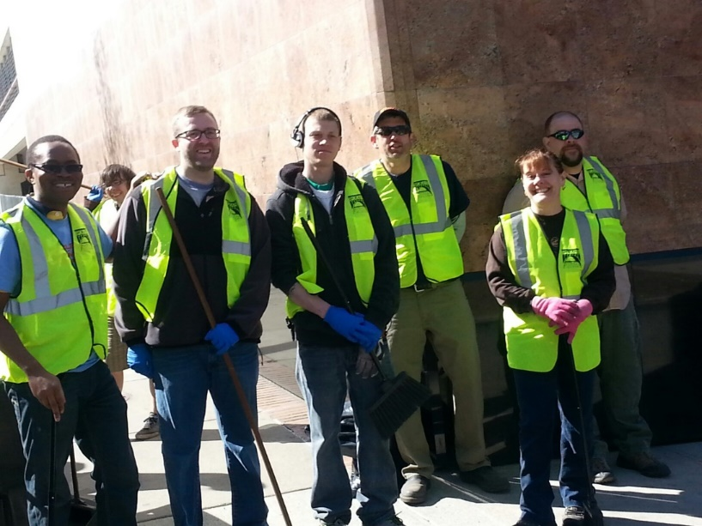
Communicating with the Community
Policy & Procedure Manual
Weekly Zoom Community Wide Staffing Meeting
Continuous community engagement
Community Outreach
Weekly core team strategy meetings
Statistics
“If you did not measure it, it didn’t happen”
WSU longitudinal study
City of Spokane Municipal Community Court

Slide 7
Achieving Workable Unity
Core Partners
Spokane Police Department
Spokane Municipal Court
City Prosecutor
City Public Defender
Spokane Municipal Probation
Center for Court Innovation
Spokane Public Library
Spokane Central Lion’s Club
Providence Medical Group
CHAS Clinic
Downtown Spokane Partnership
Volunteers of America
Catholic Charities of Spokane
Pioneer Human Services
Spokane Consistent Care
Women’s Hearth

Slide 8
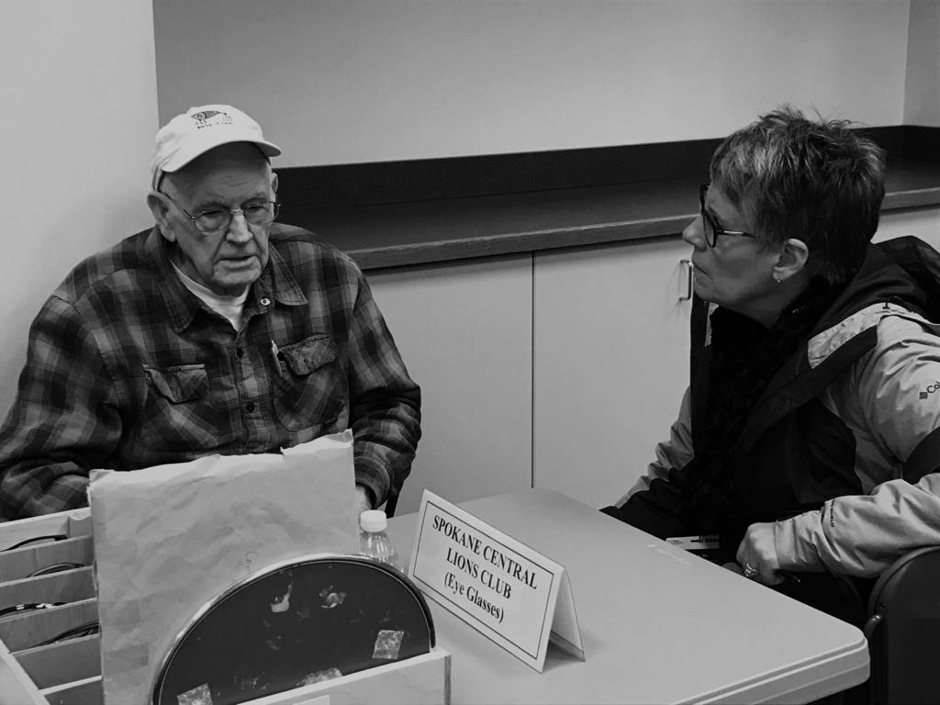
Delivering Services to Participants
Housing
Medical
Behavioral Health services
Education
Department of Licensing (identification)
Payee services
Employment
Disability assistance
Hygiene
Vision
Civil/Legal
Victim advocacy and family support services
Peer and family mental health support
Veteran’s services
Faith-based services
City of Spokane Municipal Community Court

Slide 9
Response for Covid19
Warrants only issued in extreme cases
Court is operating in a reduced capacity
Cell Phones and Tablets available in Court for Zoom Meetings
Weekly Staffing Meeting changed to Zoom

Slide 10
Spokane Community Response
“This court has the ability to reach people on a different level. I feel like we are reaching out to them where they are and offering support as we stand together. We are not standing apart in this endeavor.”
–Janis Olson, RN, Providence Consistent Care

Slide 11
Thank you!
Questions?
Comments?
Website Link:
https://www.spokanelibrary.org/community-court/
Email Court Coordinator Seth Hackenberg
Shackenberg@spokanecity.org

