Slide 2
WHAT BIG TABLE DOES we care for the WORKING POOR
in the place with the highest concentration of need in the nation
… the restaurant and hospitality industry

Slide 3
concentration of need
single parents, at-risk teens, minorities, immigrants, ex-felons

Slide 4
1 in 6
restaurant workers lives
below the poverty line

Slide 5
43 percent
are just above the poverty line
DOUBLE the rate in any other industry

Slide 6
SPOKANE
industry average FULL TIME salary
$21,870
cost of living with just one child
$45,690

Slide 7
REFERRAL MODEL

Slide 8
Power of Presence Video

Slide 9
WHAT BIG TABLE DOES we catch people before they slip off the ledge rather than pick them up off the pavement after they fall

Slide 10
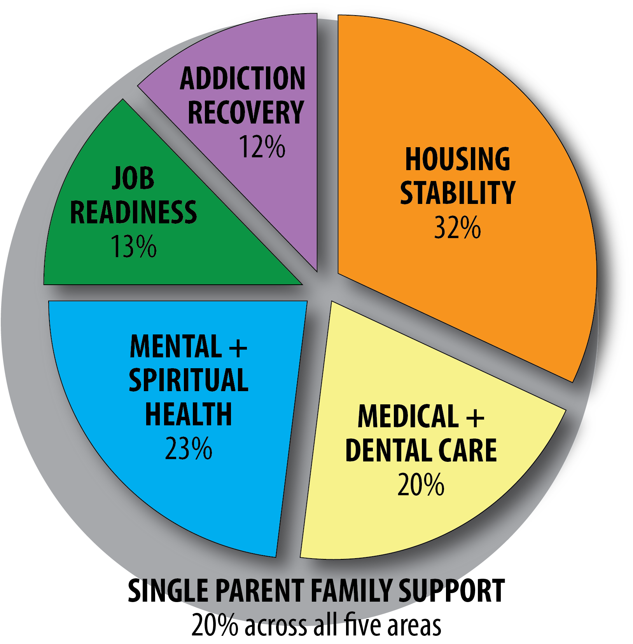

Slide 11
HOUSING STABILITY
in 2016, Big Table helped 61 families
at an average of $520 a family
in 2017, half of our care budget went to housing stability

Slide 12
HOUSING STABILITY
our tracking has shown 90% of those we assist remain in stable housing six month later

Slide 14
GET IN TOUCH
WWW.BIG-TABLE.COM
Jill Lemon | jill@big-table.com
Chris Deitz | chris@big-table.com

Slide 15
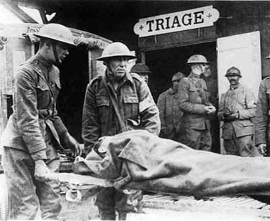
THE BIGGEST PICTURE CRISIS OF CARE IN OUR COUNTRY

Slide 16
WHO?
the WORKING poor

Slide 17
WHY?
largest industry in the nation
full of incredible people
also the most BRUTAL in our nation with a level of concentrated need no other industry comes close to

Slide 18
drug access and abuse
alcohol use and abuse
broken relationships
uncertain pay
long changing hours
constant stress
limited safety net

Slide 19
HOW?
C – create COMMUNITY around the table
A – immediately ASSIST in crisis
R – invest in ongoing RELATIONSHIPS
E – EDUCATE and ENGAGE others to care

